Slide 1
Case Study: Reflections on the Wheel of Life
Understanding Life Balance through Personal Reflection

Slide 2
Introduction to Wheel of Life
The Wheel of Life is a tool used for personal reflection and self-assessment across key areas of life. It helps individuals identify imbalances and prioritize actions for improvement. In this case study, we follow John, a 35-year-old software engineer, as he uses the Wheel of Life to reflect on his life and make changes.

Slide 3
Case Study: John's Journey
John is a 35-year-old software engineer experiencing burnout. He uses the Wheel of Life to assess his satisfaction across eight key areas of his life. After rating each area, he realizes that while his career and finances are strong, his health, personal growth, and recreation are lacking.

Slide 4
Categories: The Wheel of Life covers eight key areas: Career, Health, Family & Relationships, Finances, Personal Growth, Fun & Recreation, Contribution, and Spirituality.
Scoring: John has rated his satisfaction in each of these areas on a scale of 1 to 10. The higher the score, the more satisfied he is with that area of life.
Imbalance: The uneven shape of the chart shows the imbalance in John's life. For example, his Career (8/10) and Finances (7/10) are strong, but areas like Health (3/10), Fun & Recreation (2/10), and Personal Growth (4/10) are much lower.
Reflection: This visual representation allows John to see where he needs to focus his efforts in order to improve his overall life satisfaction. In this case, prioritizing health, recreation, and personal growth will help balance the wheel, leading to a more fulfilling life.

Slide 5
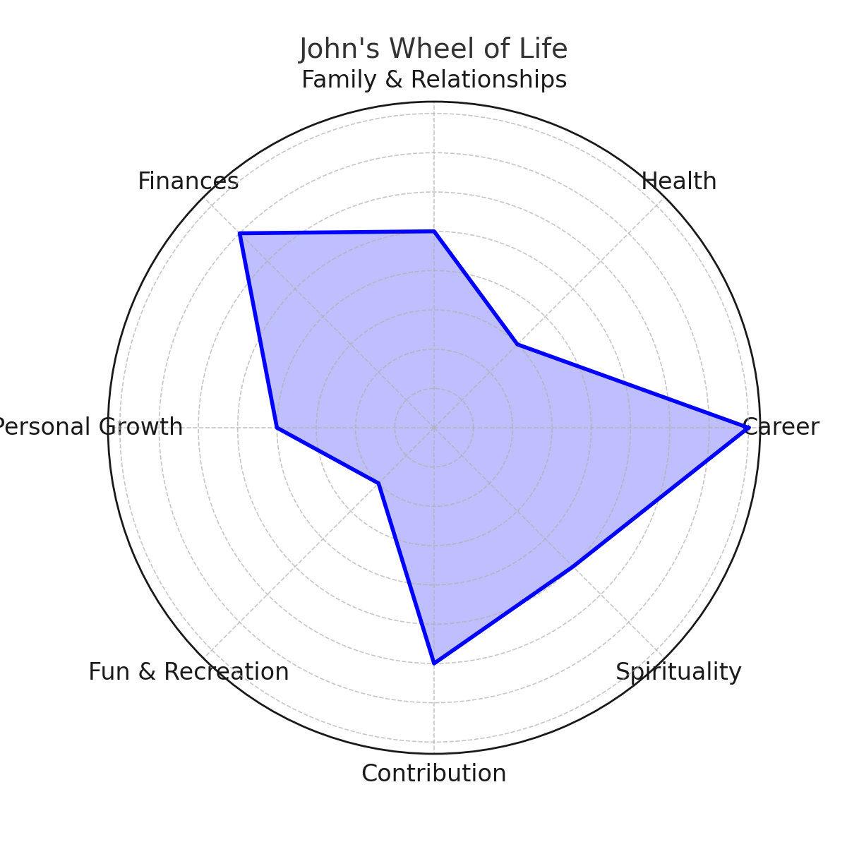
John's Wheel of Life

Slide 6
Conclusion and John's Action Plan
After reflecting on the Wheel of Life, John identifies key areas to improve:
- Health: Committing to daily exercise and healthier eating.
- Family & Relationships: Spending more quality time with family.
- Personal Growth: Re-engaging in reading and workshops.
- Fun & Recreation: Rediscovering his photography hobby.
By focusing on these areas, John is able to achieve a more balanced and fulfilling life.

